Slide 1
ONLINE TRANSPORTATION NETWORK SYSTEM
Haider Ali Molla
Subayyal Mustafvi
Subham Keshri
Tasnim Khan
Date: December 01, 2016

Slide 2


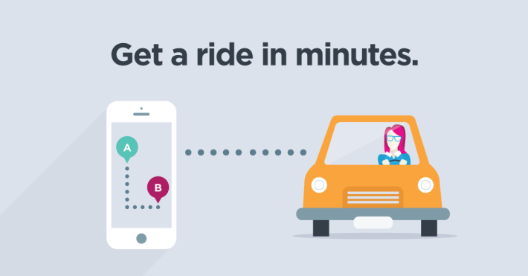
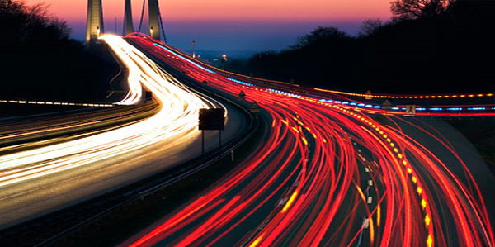
Introduction
Make commute easy
Safe Commute
Make commute fast
Less waiting time

Slide 3
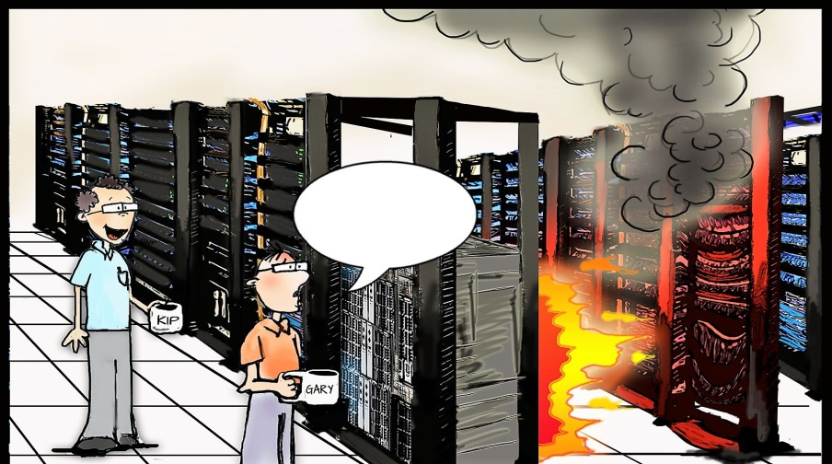
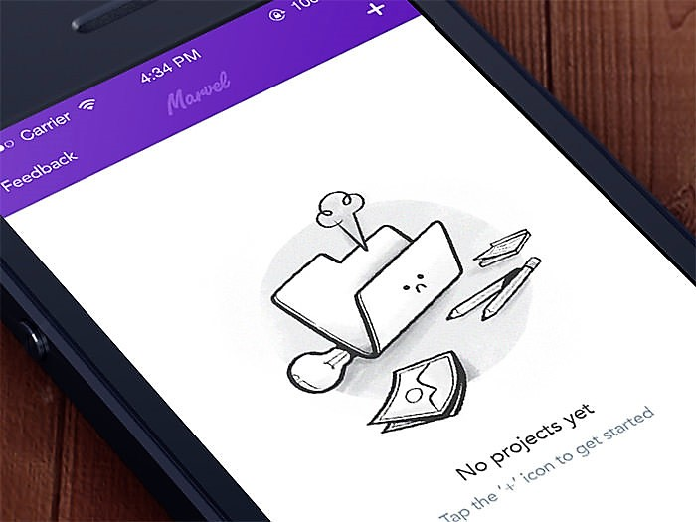
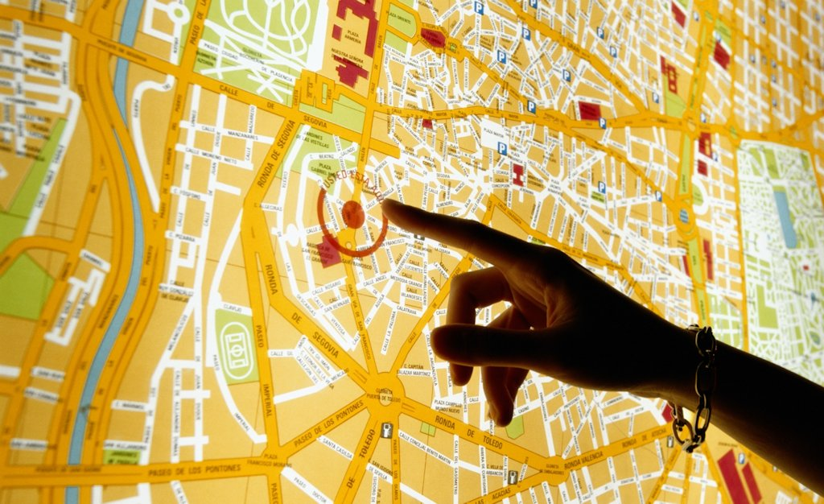
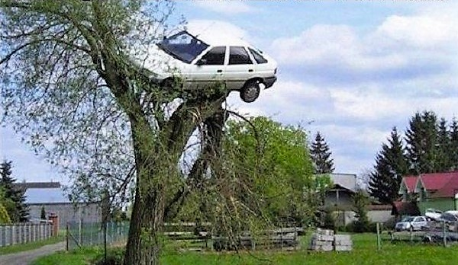
List of Requirements
Interface for the Users
Server/Database System
Car Service
Map API Plugin

Slide 4
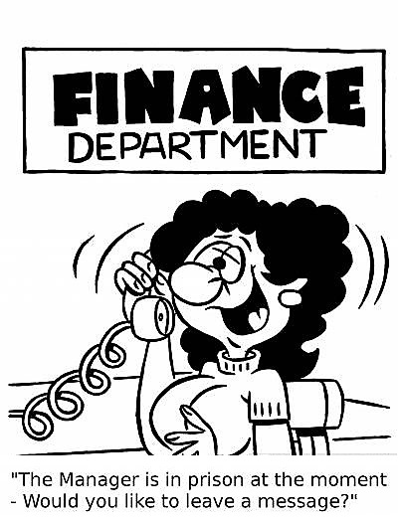

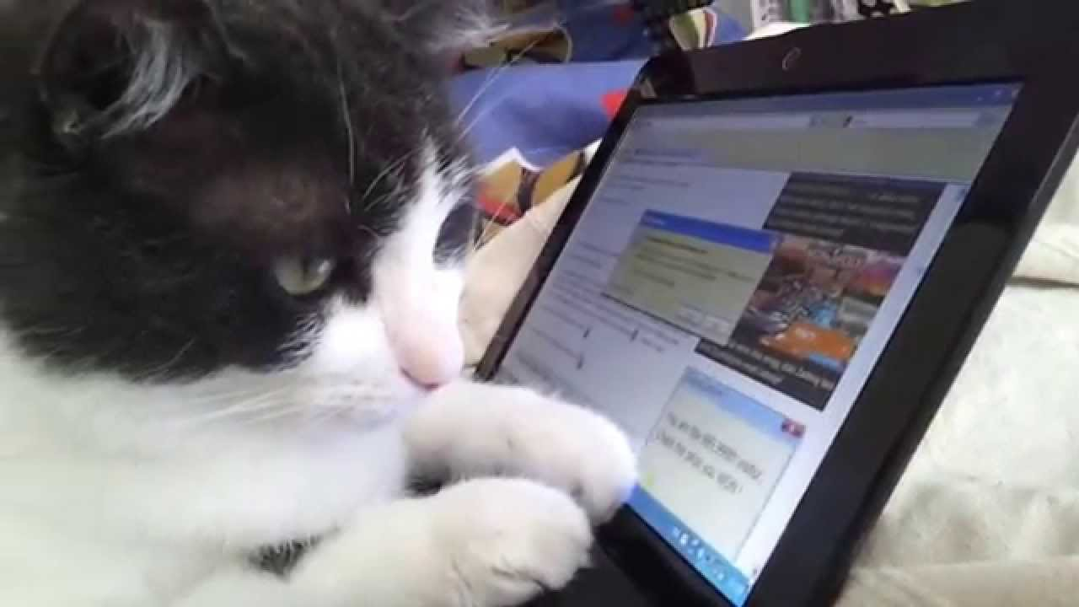
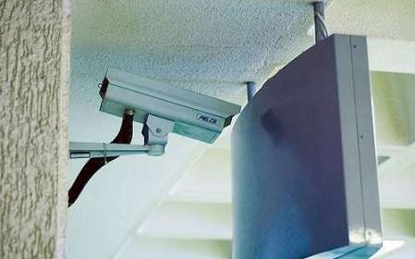
List of Requirements (continued…)
Financial System
Security System
Communication
System
Safety
System

Slide 5

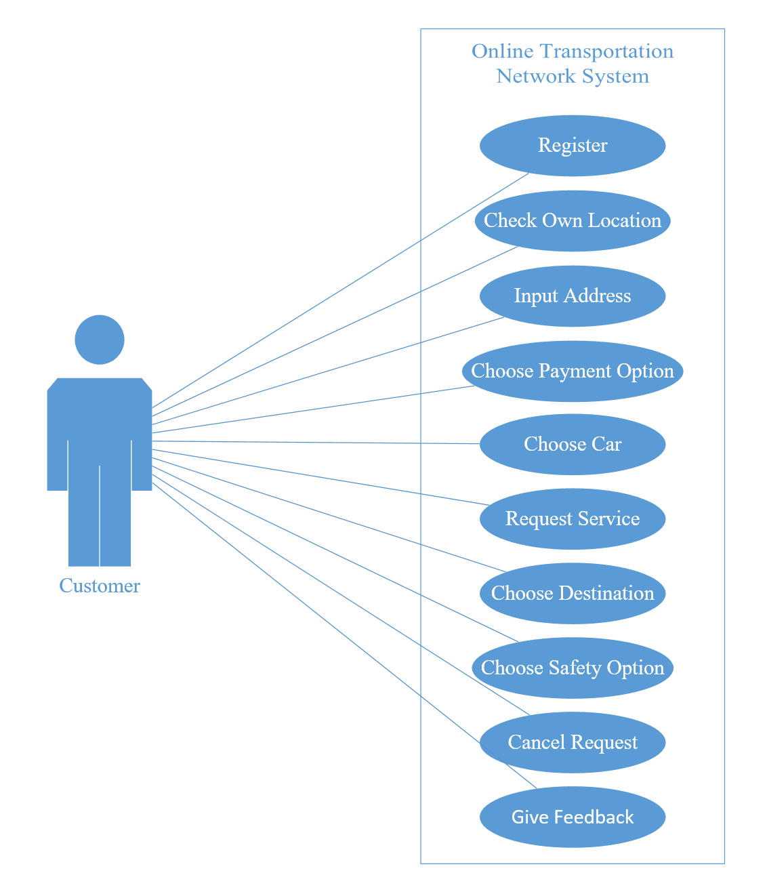
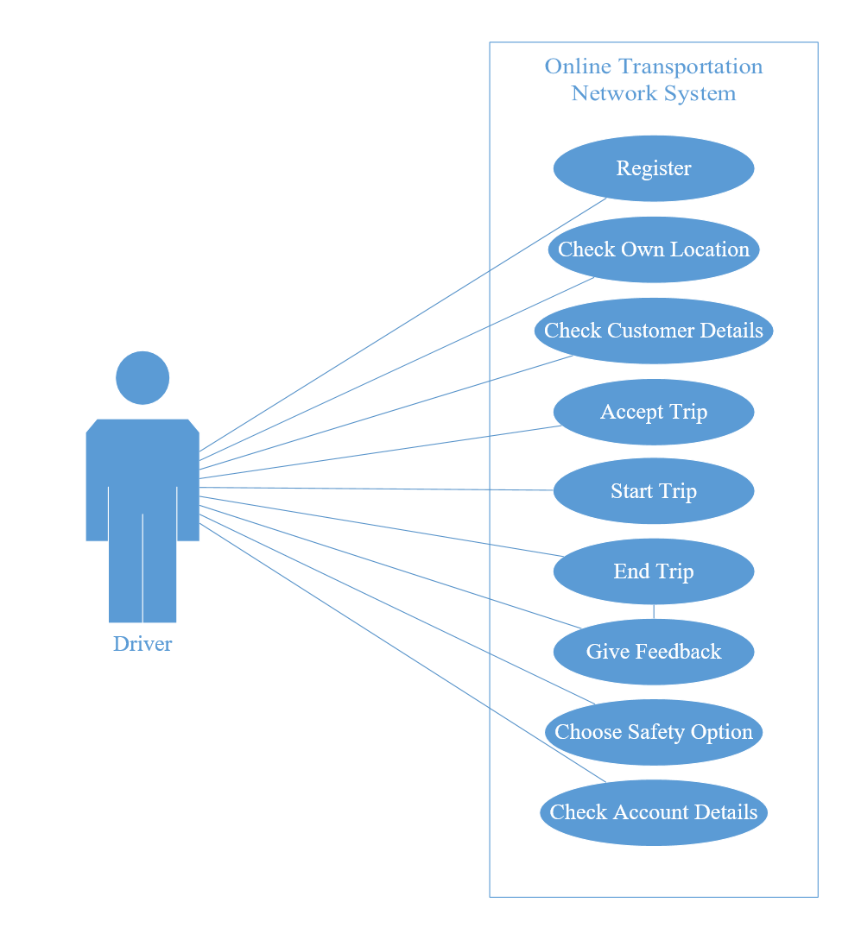
Use Case Diagram
Due to too many requirements, we have mainly focused on registration and requesting service.

Slide 6
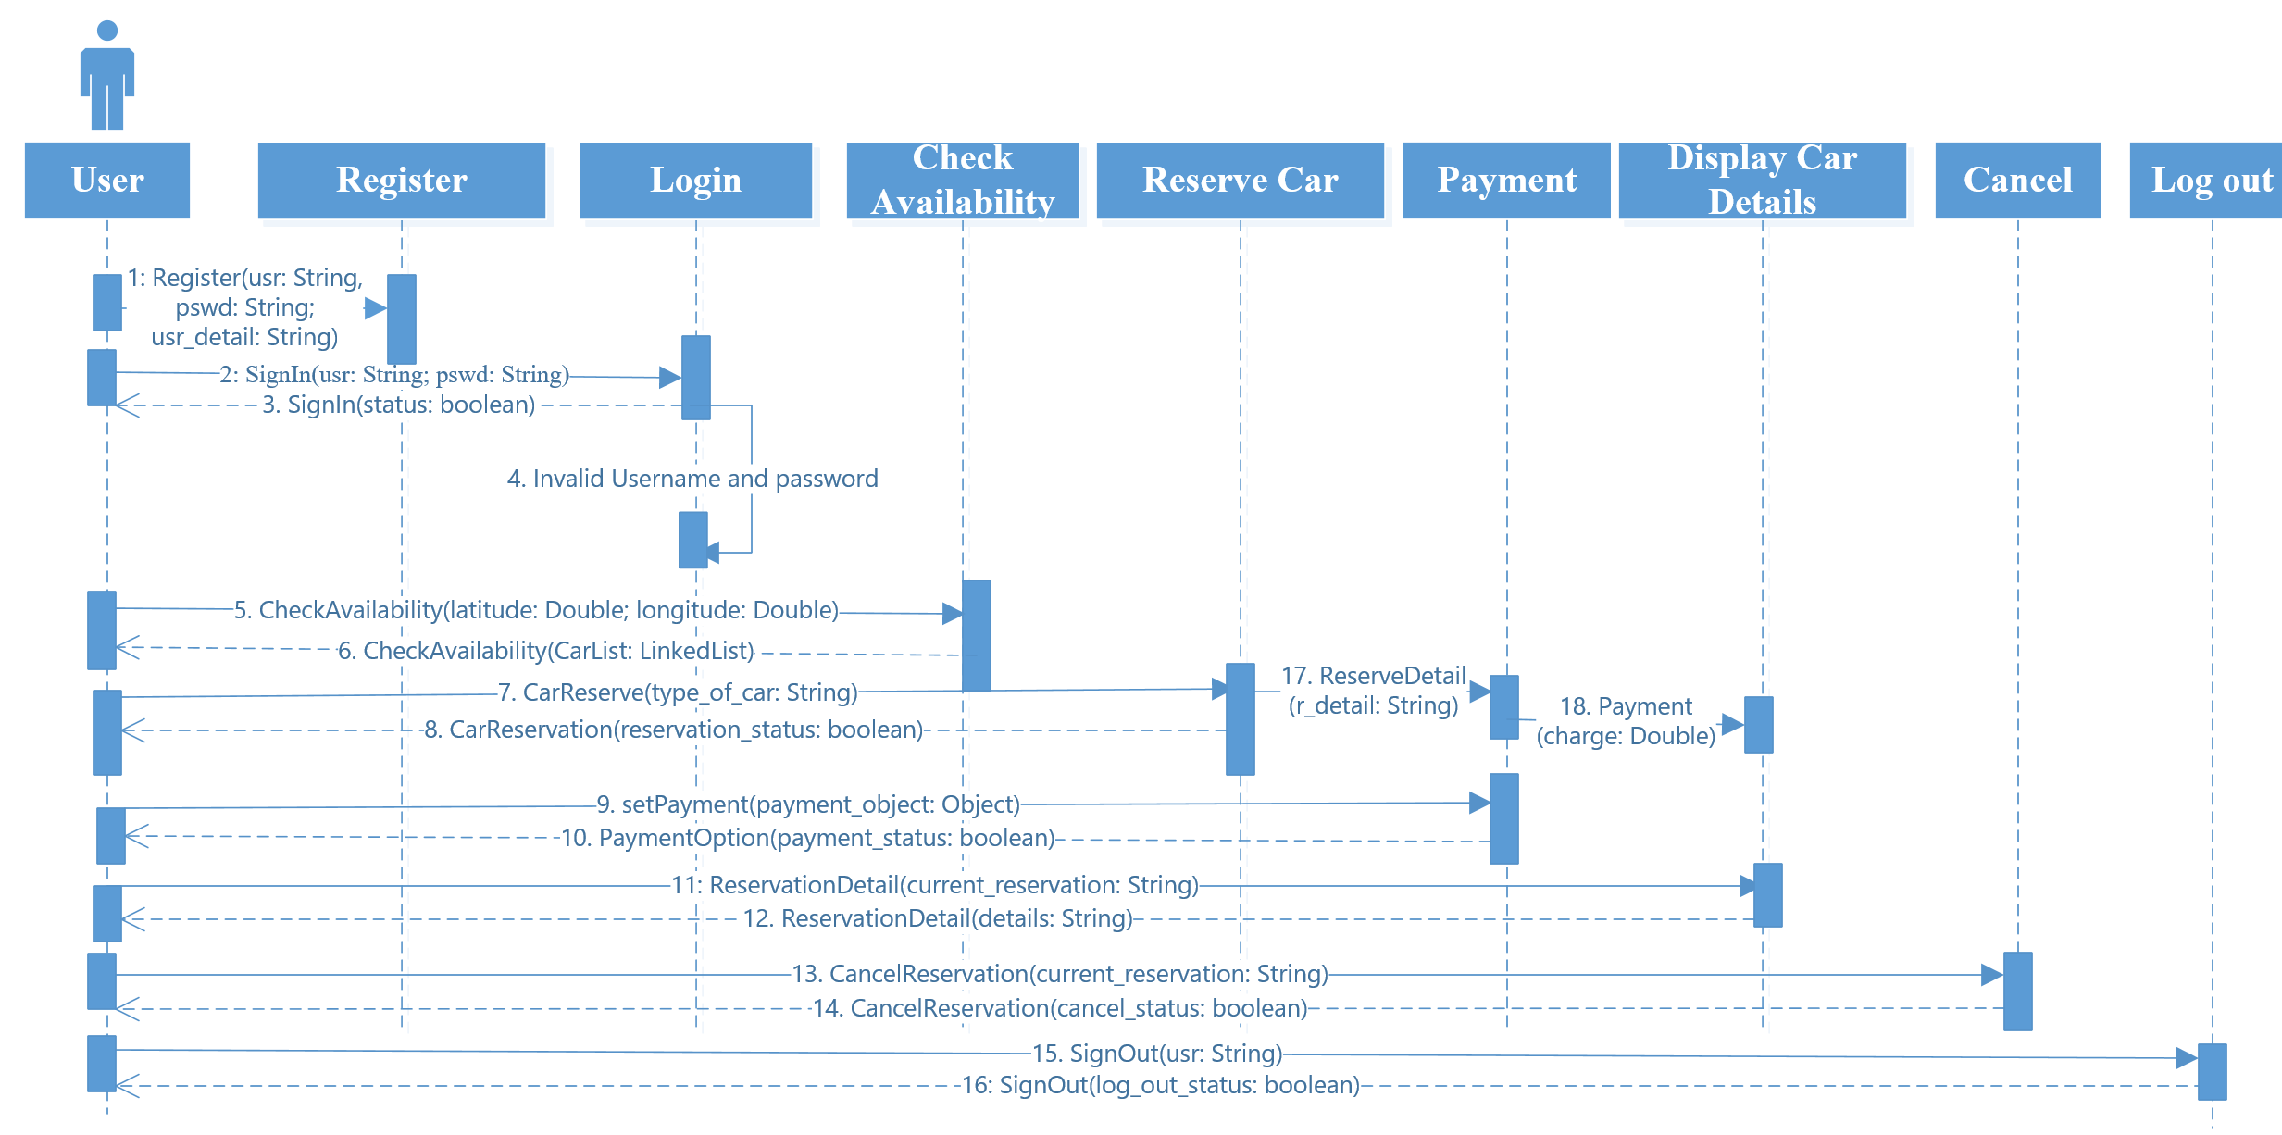
Sequence Diagram
This is based on the reservation process scenario for a new user.

Slide 7
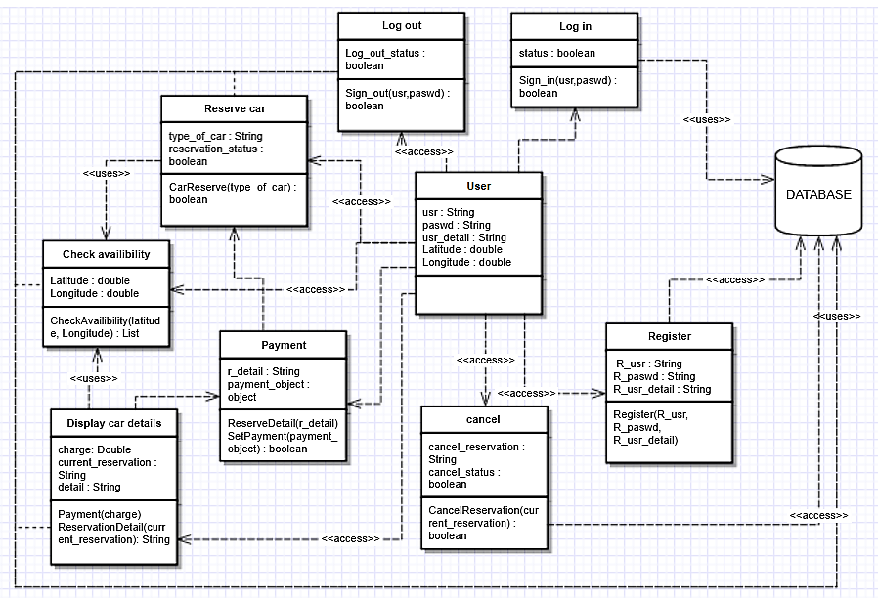
Design Class Diagram (DCD)
This is based on the reservation process scenario for a new user.

Slide 8

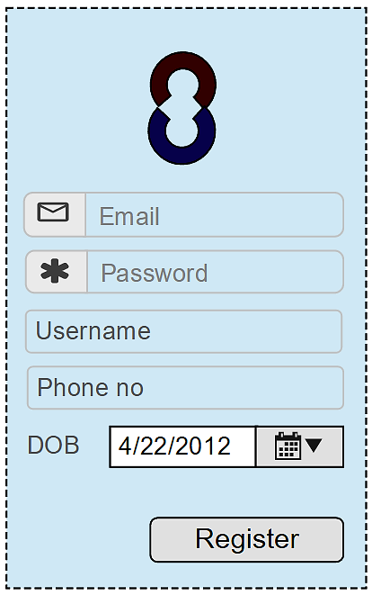
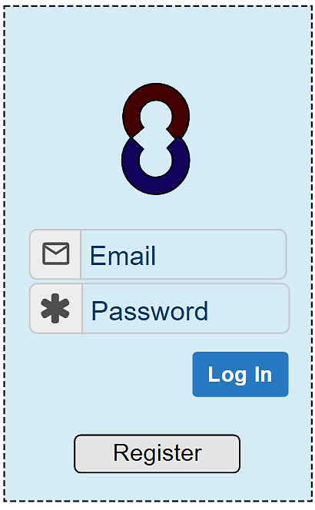
User Interface Design
This design handles the registration process for users.

Slide 9
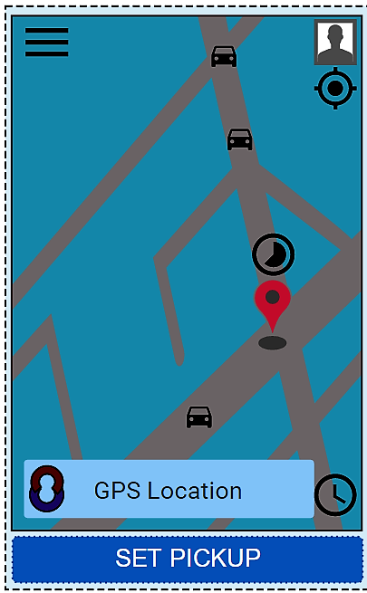
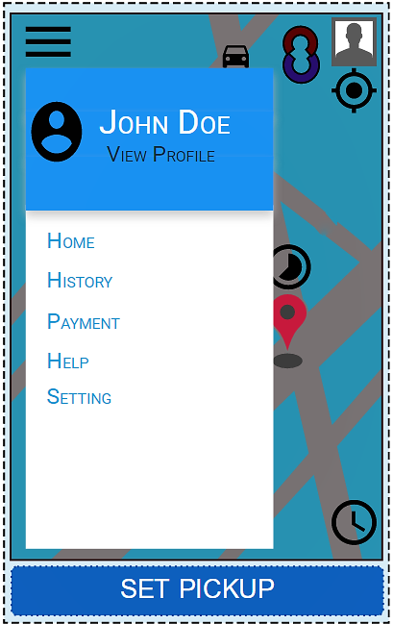
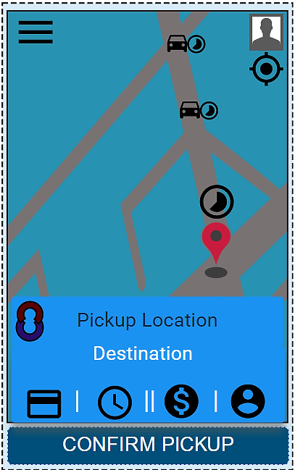
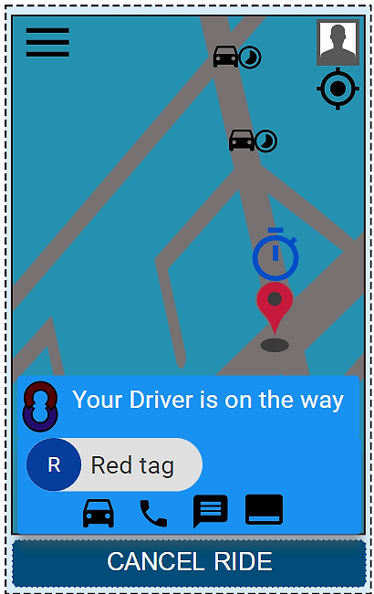
User Interface Design(continued…)
This design handles the process of requesting service

Slide 10






Comparison

Slide 11
Conclusion
Great learning experience.
Each stage is important.
Better understanding of Software design process.
Processes and methodologies makes software development easier to manage.

Slide 12
Reference
"Comic Server", Whyweprotest.net, 2016. [Online]. Available: https://whyweprotest.net/attachments/cartoon-virtualized-server-jpg.242531/. [Accessed: 18- Nov- 2016].
"Empty State Interface", Media02.hongkiat.com, 2016. [Online]. Available: http://media02.hongkiat.com/mobile-app-empty-state-designs/8-empty-state-mobile-app-designs.jpg. [Accessed: 18- Nov- 2016].
"Car Service", Cdn2-craveonline.com, 2016. [Online]. Available: http://cdn2-www.craveonline.com/assets/uploads/2015/09/man_file_1061878_uber-driver-be-like.jpg. [Accessed: 18- Nov- 2016].
"Financial System", S3.amazonaws.com, 2016. [Online]. Available: https://s3.amazonaws.com/lowres.cartoonstock.com/law-order-financial_manager-finance_department-prison-prison_sentence-white_collar_crime-tnen163_low.jpg. [Accessed: 18- Nov- 2016].
"Communication", Thumbs.dreamstime.com, 2016. [Online]. Available: https://thumbs.dreamstime.com/z/pony-express-5638802.jpg. [Accessed: 18- Nov- 2016].
"Map Service", Gajotres.net, 2016. [Online]. Available: http://www.gajotres.net/wp-content/uploads/2015/07/ionic-geolocation-google-maps.jpg. [Accessed: 18- Nov- 2016].
"Safety System Fail", Kentonbrothers.com, 2016. [Online]. Available: http://www.kentonbrothers.com/wp-content/uploads/2013/03/security-fail.jpg. [Accessed: 18- Nov- 2016].
"Security Funny", I.ytimg.com, 2016. [Online]. Available: https://i.ytimg.com/vi/hVrhJtVp5Ls/maxresdefault.jpg. [Accessed: 18- Nov- 2016].
"Questions", 3coast.com, 2016. [Online]. Available: http://www.3coast.com/wp-content/uploads/2013/09/bigstock__D_Human_And_Blue_Question_MarSMALL1.jpg. [Accessed: 18- Nov- 2016].
"Answers", Inceptionplumbing.com, 2016. [Online]. Available: http://inceptionplumbing.com/wp-content/uploads/2016/01/q-a.png. [Accessed: 18- Nov- 2016].

Slide 13


Questions???

Slide 14
Contact
Haider Ali Molla
-ham140330@utdallas.edu
Subayyal Mustafvi
-sxm136531@utdallas.edu
Subham Keshri
-subham.keshri@utdallas.edu
Tasnim Khan
-tasnim.khan@utdallas.edu

